Slide 1

University Of Canberra
WEEK11
Pattern Recognition and Machine Learning
Created by
Elane Peng

Slide 2
Objectives
Understand the fundamental components and architecture of CNNs – including convolutional layers, activation functions, pooling layers, and fully connected layers, and how they work together to process and learn from image data.
Develop practical skills in building and training CNNs – including data preprocessing, model design, parameter tuning, and evaluation metrics for image classification or related tasks.
Analyze and interpret CNN performance – including visualization of learned features, understanding overfitting/underfitting, and applying techniques like transfer learning or regularization to improve model accuracy and generalization.

Slide 3
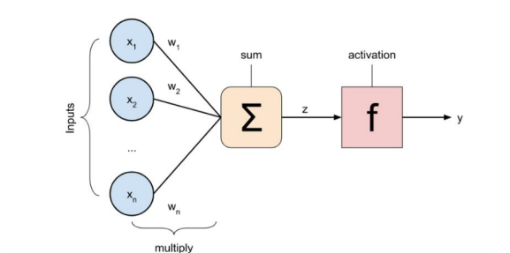


Neural Network
4. What are the main components of a neural network, and how do they function? Explain the computation process of a neuron.
Computation:
• Weighted sum of its inputs, b is the bias term, which allows the neuron to shift the activation function and improves flexibility.
• Activation function, introduces non-linearity, allowing the network to learn complex patterns.

Slide 4
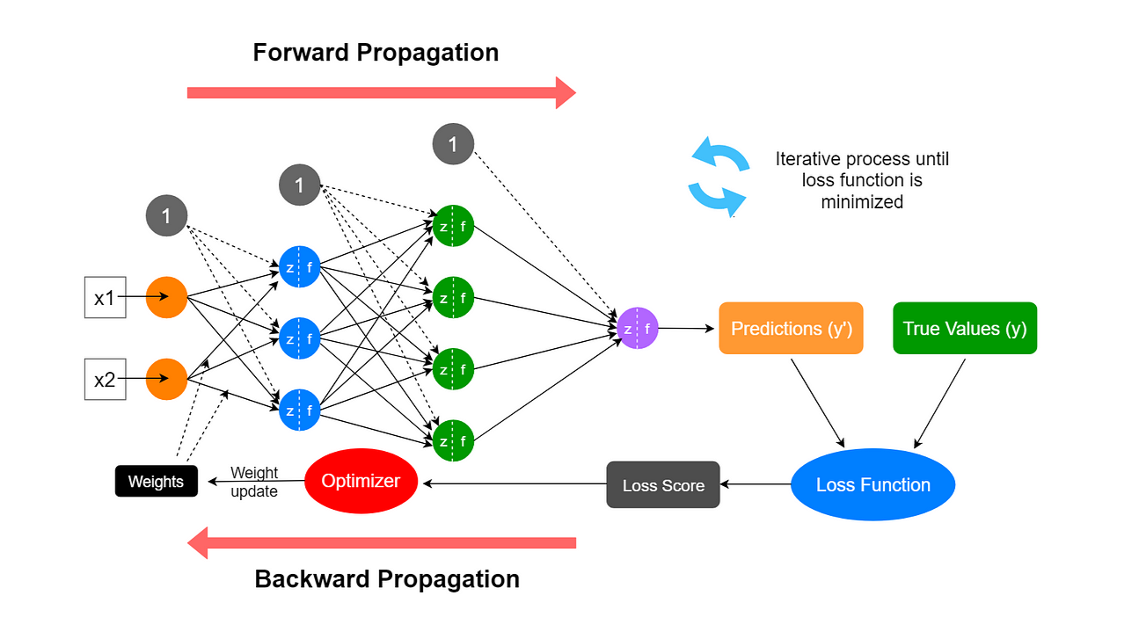
Neural Network

Slide 5

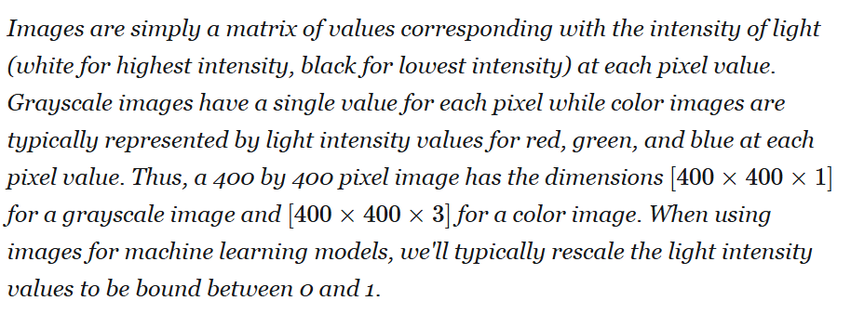
CNN

Slide 6
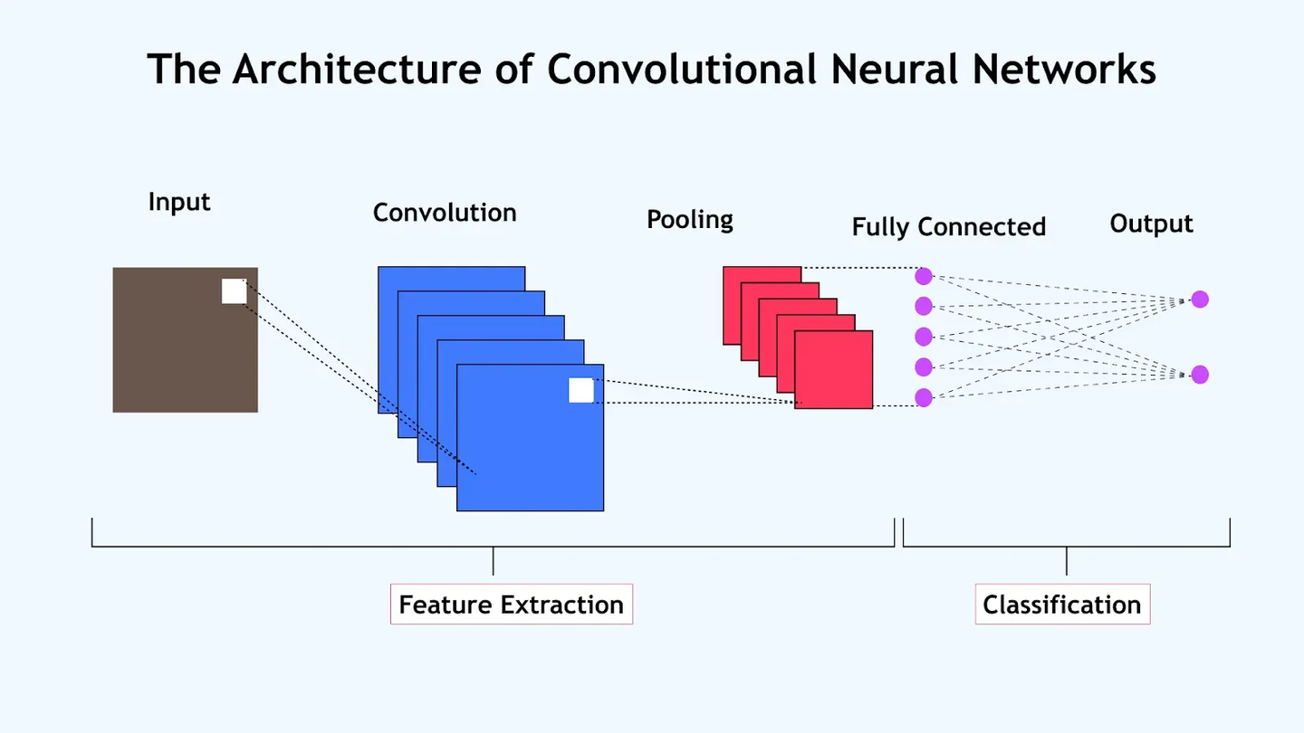
CNN
1. Building a CNN Architecture
• CNNs typically consist of Conv2D layers with ReLU activations, MaxPooling2D layers for downsampling, and Dense layers for classification.
• Architecture depends on task complexity and dataset.

Slide 7
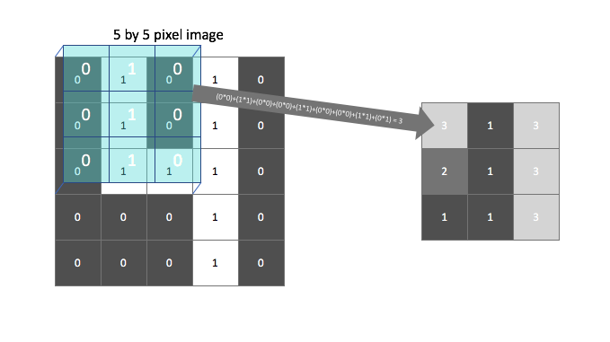

CNN
Multiplies the numbers in that patch by the numbers in the kernel (element by element).
Adds them all up.
Puts the result into a new grid (the “output image”).

Slide 8
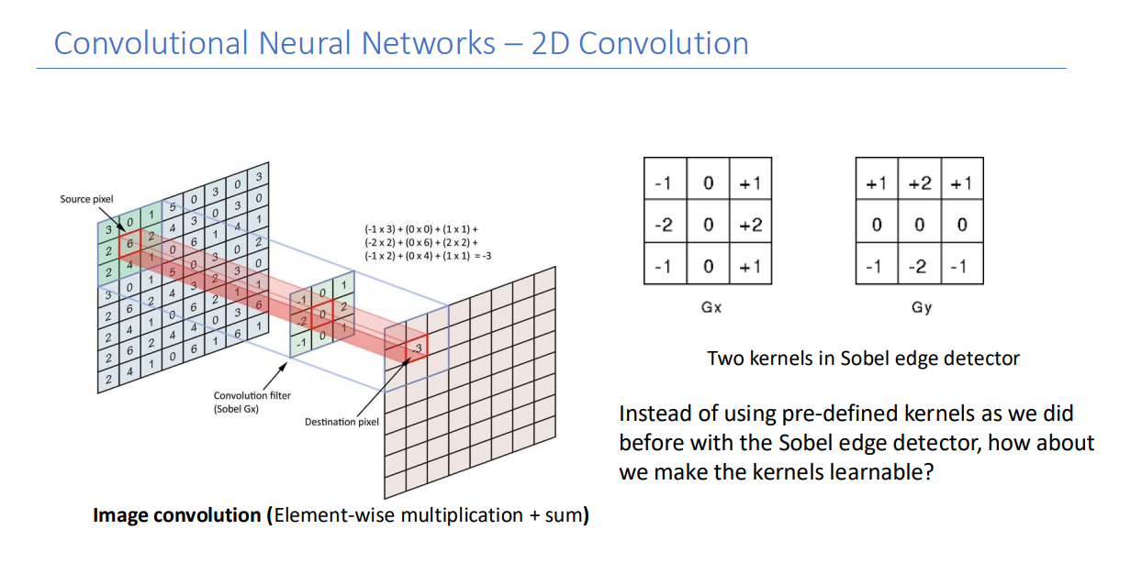
CNN

Slide 9
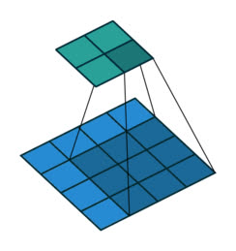
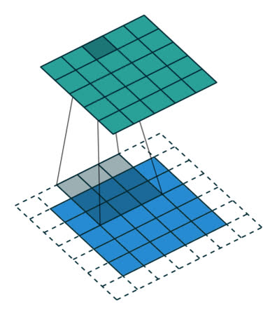
CNN

Slide 10
CNN
3. Sobel vs. CNN
In the example, the Sobel kernels (Gx and Gy) are manually designed.
Humans decided those numbers because they work well for edge detection.
But in a Convolutional Neural Network (CNN), the kernel values are learned automatically during training.
The network figures out by itself what numbers help it recognize cats, cars, or letters.
That’s why CNNs are powerful — they learn their own “best filters” instead of relying on hand-crafted ones.

Slide 11
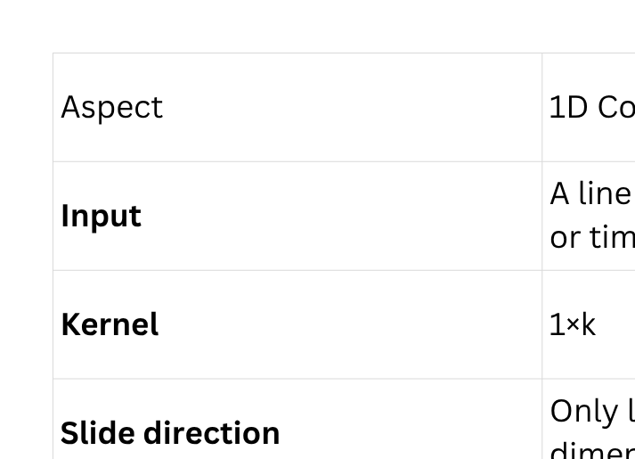
CNN
Difference between 1D and 2D Convolution

Slide 12
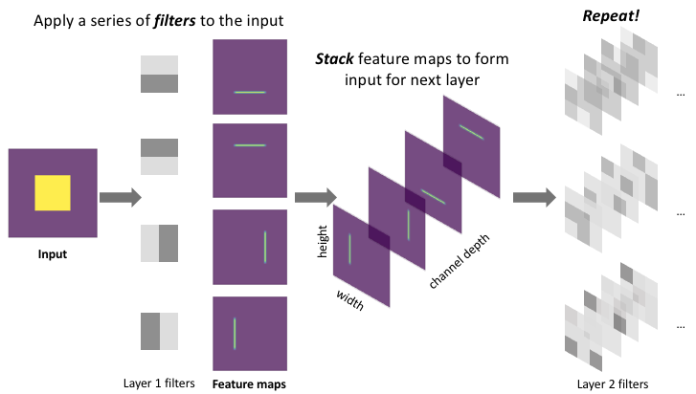
CNN
Conv2D (Convolutional Layer):
It is responsible for extracting local features from an image — such as edges, textures, shapes, or color patterns.

Slide 13
CNN
After a convolution layer, you get a “feature map” — basically a new image showing what the network has detected (edges, patterns, etc.).
MaxPooling2D takes that feature map and shrinks it while keeping the most important information.

Slide 14
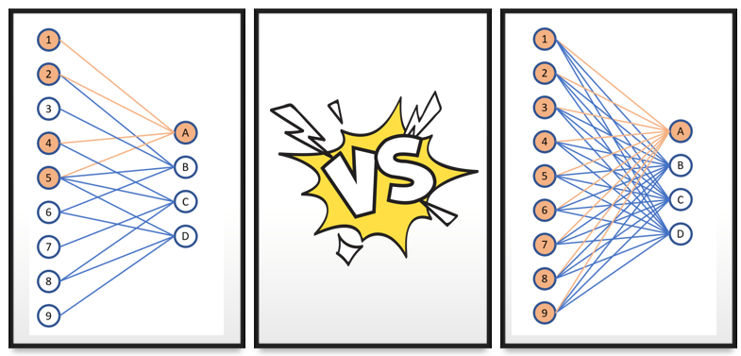
CNN
Why do CNNs use convolutional and pooling layers instead of fully connected layers for image tasks?
Convolutional layers capture spatial features and reduce parameters; pooling layers reduce spatial dimensions and overfitting

Slide 15
CNN
2. Data Preprocessing
• Resize images to a consistent shape (e.g., 32×32 for CIFAR-10).
• Normalize pixel values (e.g., scale to [0,1]).
• Optionally, apply data augmentation: rotation, flipping, random cropping.

Slide 16
CNN
How does data augmentation help CNNs?
Answer: It increases dataset diversity, reduces overfitting, and improves generalization.

Slide 17
CNN
3. Convolution and Pooling
• Convolution: Apply filters to extract features (edges, textures, patterns).
• Pooling: Reduce spatial size; MaxPooling keeps the strongest response, AveragePooling averages values.

Slide 18
CNN
3. Convolution and Pooling
• Convolution: Apply filters to extract features (edges, textures, patterns).
• Pooling: Reduce spatial size; MaxPooling keeps the strongest response, AveragePooling averages values.

Slide 19
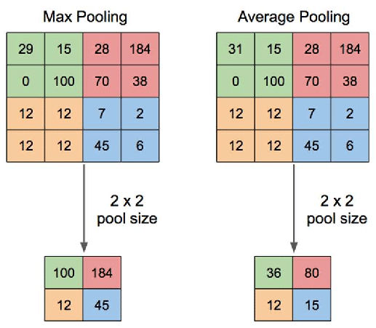
CNN
What is the difference between MaxPooling and AveragePooling? Answer: MaxPooling selects the maximum value, emphasizing strong features; AveragePooling computes the average, preserving overall information.

Slide 20
CNN
What is the difference between MaxPooling and AveragePooling? Answer: MaxPooling selects the maximum value, emphasizing strong features; AveragePooling computes the average, preserving overall information.

Slide 21
CNN
4. Visualizing CNN Architecture
• Produces a diagram showing layer types, shapes, and connections.
Discussion Question: Why is visualizing the architecture helpful? How to interpret it?
Answer: It helps understand layer dimensions, feature map transformations, and model complexity.

Slide 22
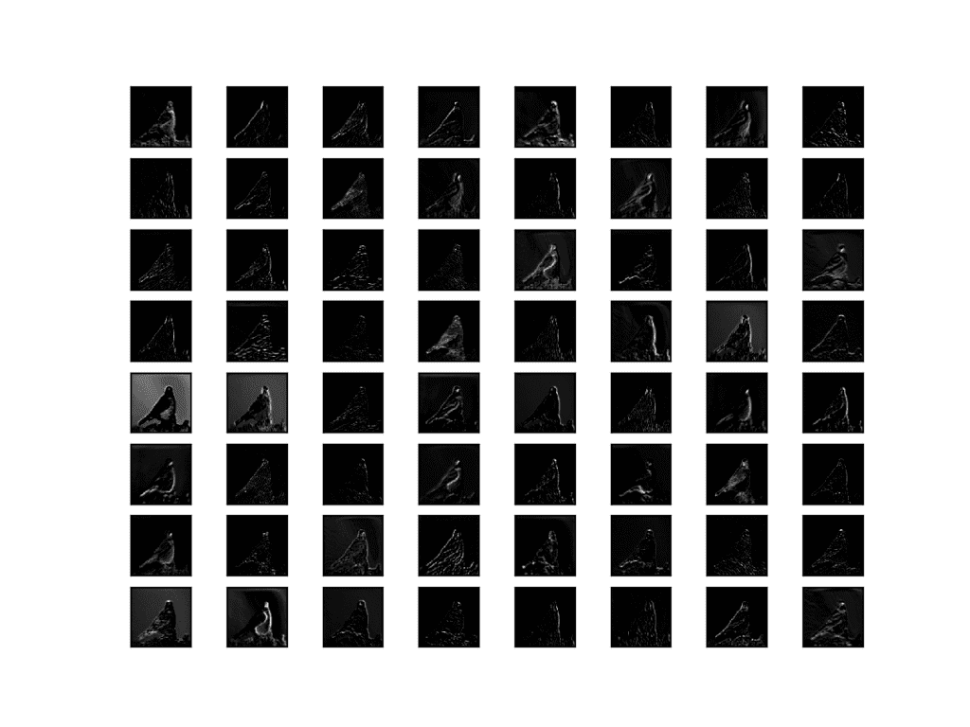
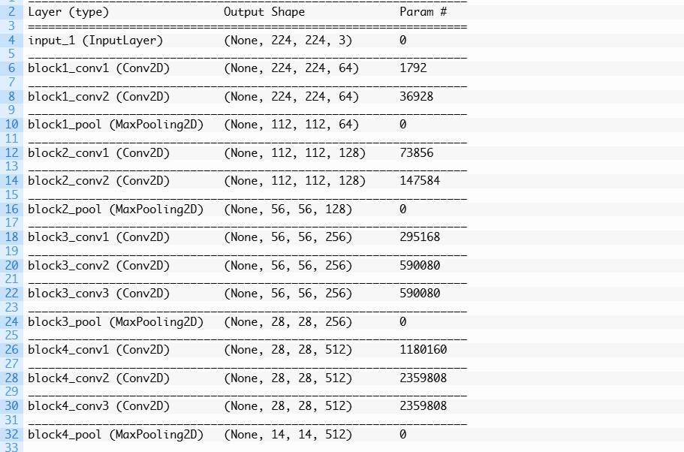
CNN

Slide 23
CNN
5. Training a CNN
• Define model (architecture) → compile (loss, optimizer, metrics) → fit on training data → evaluate on test data.
• Track accuracy and loss over epochs.
Discussion Question: What does the loss function represent during training?
Answer: It measures how far the model predictions are from the true labels; minimizing it improves model performance.

Slide 24
CNN
6. Transfer Learning
• Use pre-trained CNNs (e.g., VGG16) for a new task.
• Replace final Dense layers and fine-tune on new dataset.
Discussion Question: Why is transfer learning effective for small datasets?
Answer: Pre-trained weights already capture general features, reducing training data requirements.

Slide 25
CNN
6. Transfer Learning
• Use pre-trained CNNs (e.g., VGG16) for a new task.
• Replace final Dense layers and fine-tune on new dataset.
Discussion Question: Why is transfer learning effective for small datasets?
Answer: Pre-trained weights already capture general features, reducing training data requirements.

Slide 26
CNN
7. Visualizing Convolutional Filters
• Early filters capture edges, corners, and textures.
Discussion Question: What can filter visualization tell us about the network?
Answer: It shows what features the model is detecting at each layer; helps interpret learning.

Slide 27
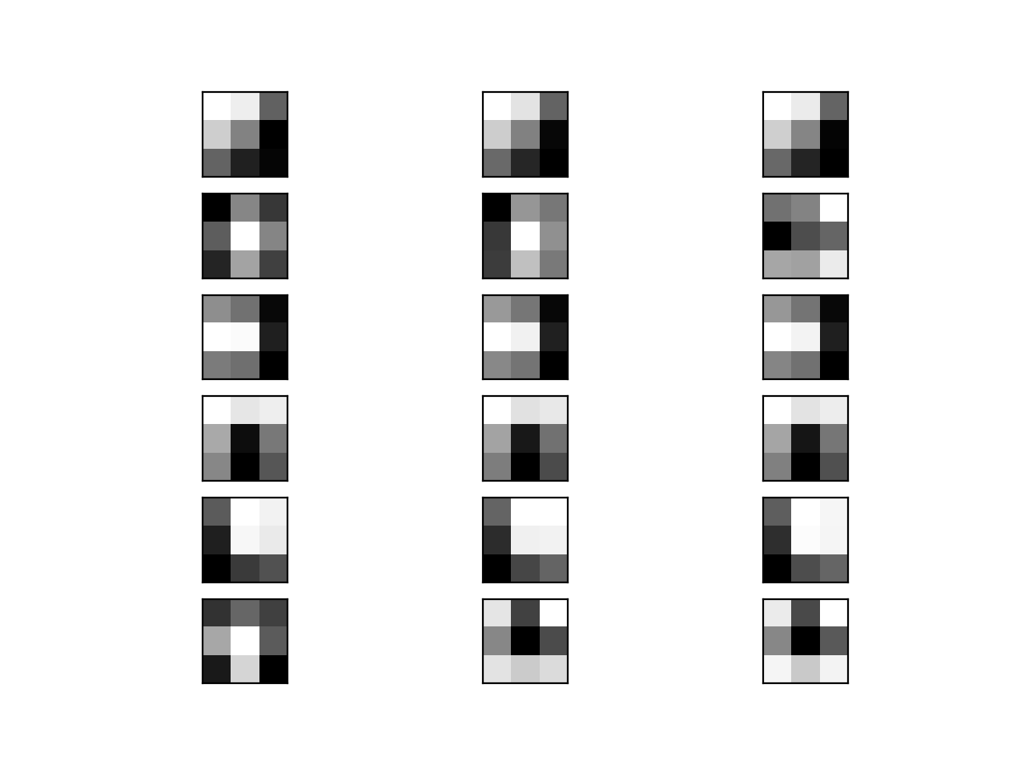
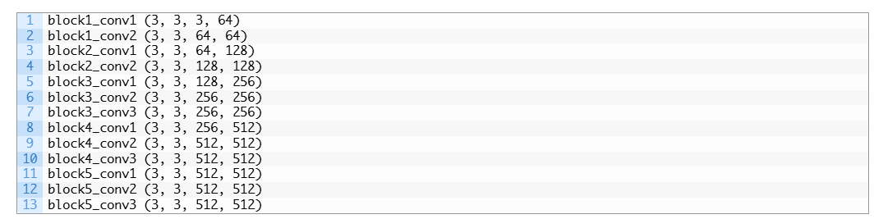
CNN

Slide 28
CNN
8. Understanding Feature Maps
• Feature maps = output of Convolutional layers.
• Represent where learned features occur in the input.
Discussion Question: How do feature maps differ from filters? Answer: Filters are learned weights; feature maps are the activation maps after applying filters to inputs.

Slide 29
CNN

Slide 30
CNN
9. Data Augmentation
• Apply transformations to reduce overfitting: rotation, flipping, cropping.
Discussion Question: Why might you not always want to augment data?
Answer: Some augmentations may distort meaningful patterns or labels, reducing accuracy.

Slide 31
CNN
9. Data Augmentation
• Apply transformations to reduce overfitting: rotation, flipping, cropping.
Discussion Question: Why might you not always want to augment data?
Answer: Some augmentations may distort meaningful patterns or labels, reducing accuracy.

Slide 32
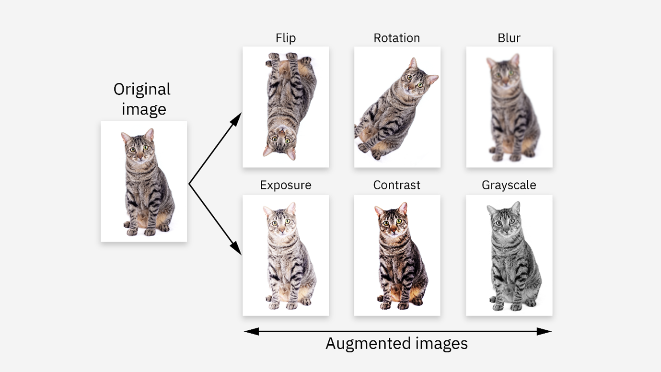
CNN

Slide 33
CNN
Why you might not always want to augment
Not all augmentations are safe or useful. Some can distort important features or change the label meaning, for example:
Rotating a “6” could make it look like a “9”.
In medical images, rotation or flipping might move or distort a lesion.
In face recognition, heavy cropping might remove key areas like eyes or mouth.
Too much or inappropriate augmentation can reduce accuracy, because the model starts learning from unrealistic or misleading examples.

Slide 34
CNN
10. Hyperparameter Tuning
• Experiment with learning rate, batch size, layer depth, and number of filters.
• Use grid search, random search, or Bayesian optimization.

Slide 35
CNN
Discussion Question:
Which hyperparameter usually has the largest impact on training stability?
Among all hyperparameters (batch size, epochs, optimizer type, etc.), the learning rate directly determines whether the model can actually learn. A well-chosen rate gives smooth, stable convergence; a bad one can completely ruin training even if everything else is perfect.

Slide 36
CNN
The learning rate is a hyperparameter that controls how big each step the model takes when updating its weights during training.
Every time the model sees a batch of data, it adjusts its internal parameters (weights) to reduce error — the learning rate decides how far it moves in that direction.

Slide 37
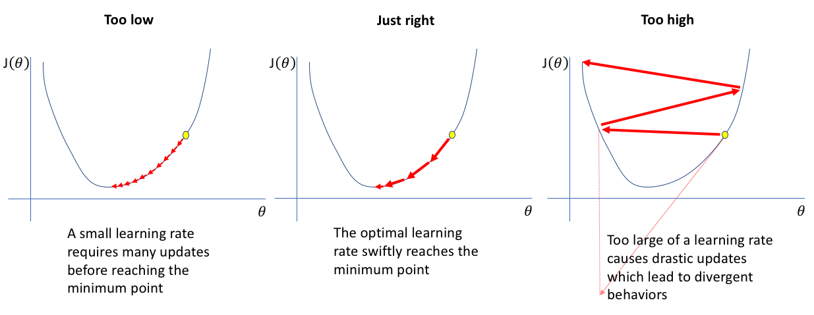
gradient descent behavior for different learning rates

Slide 38
CNN
11. Handling Imbalanced Datasets
• Use oversampling, undersampling, or weighted loss functions.
• Weighted cross-entropy can prioritize minority classes.
Discussion Question: Why is accuracy misleading on imbalanced datasets? Answer: The model may predict majority classes most of the time and achieve high accuracy without learning minority classes.

Slide 39
CNN
12. Interpreting CNN Predictions
• Saliency Maps: Highlight pixels most important for predictions.
• Occlusion Experiments: Mask parts of an image and observe prediction changes.
Discussion Question: How do these methods help understand CNN decisions? Answer: They reveal which input regions drive predictions, helping to detect biases or misclassifications.

Slide 40
Useful link
https://machinelearningmastery.com/how-to-visualize-filters-and-feature-maps-in-convolutional-neural-networks/
https://www.jeremyjordan.me/nn-learning-rate/

Slide 41


